Slide 1
Pidgins and Creoles
Charalambos Themistocleous

Slide 2
Lingua Franca
Pidgins and Creoles

Slide 3
Lingua Franca /ˌlɪŋgwə ˈfraŋkə/ : a language that is adopted as a common language between speakers whose native languages are different.

Slide 4
Pidgins and Creoles…
Hymes (1971) before 1930s pidgins and creoles were largely ignored by linguists who regarded them as ‘marginal languages’

Slide 5
---Hymes says that pidgins/creoles are marginal
In the circumstances of their origin,
The attitude towards them on part of those who speak on of the languages from which they derive
In terms of knowledge about them, even though these languages are spoken by millions of people.
Stereotypes exist because these languages are spoken by poorer and darker members of the society.

Slide 6
In recent years such attitudes have changed and there were many studies concerning pidgins and creoles.

Slide 7
Outcomes of Language Contact
Language Death: no native speakers
Language Shift: One language replaces another
Language Maintenance: A relatively stable bi-/ multilingual society
Pidgin: a rudimentary system of communication
Creole: creation of a new language based on pidgins or languages in contact
Lingua Franca
Global Languages

Slide 8
Endangered Languages
Prediction: half of the approximately 6,000 languages may become extinct within 100 years.
90 Alaskan indigenous
2 being acquired by children.
90 Australia Aboriginal
20 being used by all age groups.
175 Native American
20 being acquired by children.

Slide 9
Lingua Franca
UNESCO (1953) defined lingua franca as ‘a language which is used habitually by people whose mother tongues are different in order to facilitate communication between them.

Slide 10

Lingua Franca

Slide 11
Other terms for lingua franca related to specific purposes
Trade language: Hausa in West Africa, Swahili in East Africa.
Contact language: Greek koiné
International language: English
Auxiliary language: Esperanto or Basic English
Mixed language: Michif (see the book p. 58 my edition).

Slide 12
Lingua Franca
Although both Greek koiné and Vulgar Latin served at different times as lingua francas (for those who know Latin its of course Linguae Francae) in Ancient World, neither was a homogeneous entity. Not only were they spoken differently in different areas, but individual speakers varied widely in their ability to use the languages.
English serves today as a lingua franca in many parts of the world: for some speakers it is a native language, for others a second language, and for still others a foreign language.
However, in the last two categories abilities in the language may vary widely from native-like knowledge of only some bare rudiments..

Slide 13
Indian English: the use of English as lingua franca in India.
Swahili: is a lingua franca of East Africa: on the coast is spoken as a native language, as Swahili spread in Tanzania it was simplified in structure and even further inland in Zaire it underwent further simplification, not only in structure but in function as well.
Chinook Jargon: was used (= today is extinct) as a lingua franca among natives people of the northwest, from British Columbia into Alaska, during the second half of the nineteenth century.

Slide 14
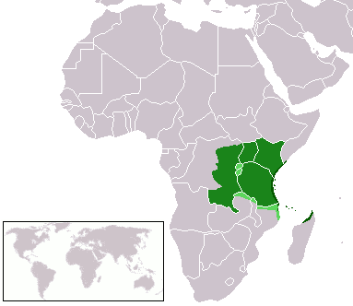
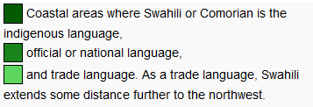
Swahili

Slide 15
1. Pidgins & Creoles: Introduction

Slide 16
Pidgin is a language with no native speakers: it is no one’s first language but is a contact language.

Slide 17
Pidgins and Creoles
Language varieties developed by speakers in contact who share no common language.
Pidgin
Limited functions of use
Adjunct language (no one speaks only a pidgin)
Linguistically simplified
Develop their own rules and norms of usage
Examples
West African Pidgin English
Chinook Jargon, Native American, British, & French traders in the Pacific Northwest, 19th c.
Solomon Island Pidgin, Solomon Islands

Slide 18
A pidgin arises from the simplification of a language when that language comes to dominate groups of speakers separated from each other by language differences,
This hypothesis partially explains
the origin of pidgins in slave societies but, in which the slaves were deliberately drawn from a variety of language backgrounds,
their origin on sea coasts.

Slide 19
Creole
Languages developed from pidgins
First language of some members of a speech community
Used for a wide range of functions
Examples
Jamaican Creole (also called patois)
Krio (Sierra Leone, Africa)
Gullah (South Carolina & Georgia)

Slide 20
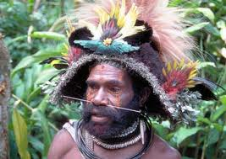
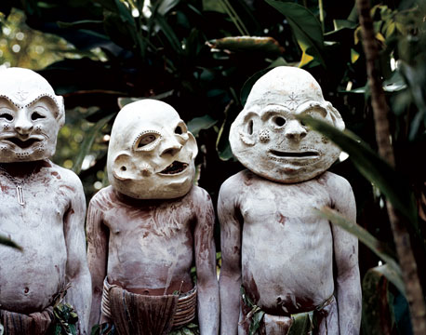
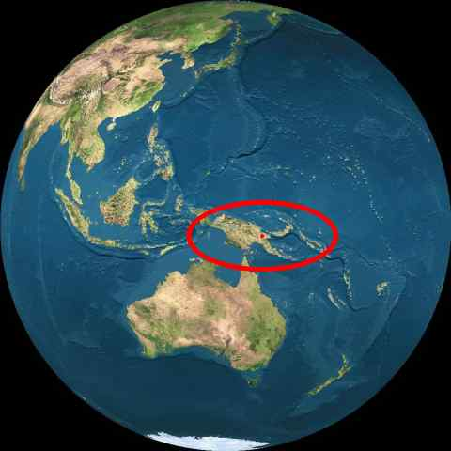
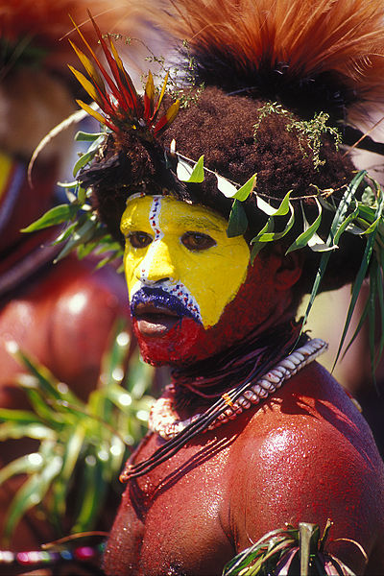
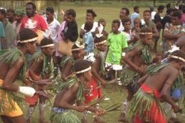
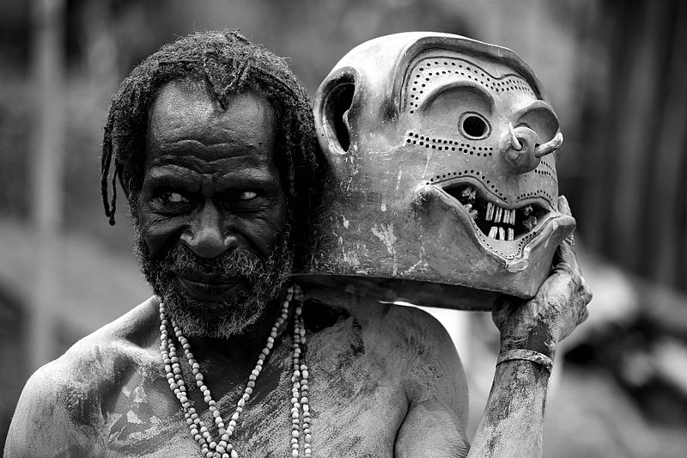
Tok-Pisin Papua New Guinea

Slide 21
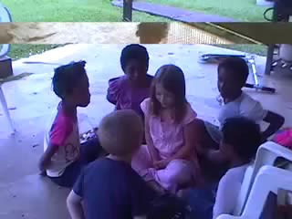
Notes:
TOK PISIN

Slide 22

Creole Languages (82)
AFRO-SEMINOLE CREOLE USA
AMAPA CREOLE Brazil
ANGOLAR São Tomé e Príncipe
ARABIC, BABALIA CREOLE Chad
ARABIC, SUDANESE CREOLE Sudan
AUKAN [DJK] Suriname
BAHAMAS CREOLE ENGLISH Bahamas
BAJAN [BJS] Barbados
BAY ISLANDS CREOLE ENGLISH Honduras
BERBICE CREOLE DUTCH Guyana
BETAWI Indonesia (Java and Bali)
BISLAMA Vanuatu
CAFUNDO CREOLE Brazil
CHAVACANO Philippines
CRIOULO, UPPER GUINEA Guinea-Bissau
CUTCHI-SWAHILI Kenya
DUTCH CREOLE U.S. Virgin Islands
FA D'AMBU Equatorial Guinea
FERNANDO PO CREOLE ENGLISH Equatorial Guinea
FRENCH GUIANESE CREOLE FRENCH French Guiana
GUYANESE CREOLE ENGLISH Guyana
HAITIAN CREOLE FRENCH Haiti
HAWAII CREOLE ENGLISH USA
INDO-PORTUGUESE Sri Lanka
INDONESIAN, PERANAKAN Indonesia
KARIPUNA CREOLE FRENCH Brazil
KITUBA Democratic Republic of Congo
KORLAI CREOLE PORTUGUESE India
KRIO Sierra Leone
KRIOL Australia
KWINTI Suriname
LEEWARD CARIBBEAN CREOLE ENGLISH Antigua
LESSER ANTILLEAN CREOLE FRENCH St. Lucia
LOUISIANA CREOLE FRENCH USA
and so on...
http://www.ethnologue.com/web.asp

Slide 23
Sources of Linguistic Features
Superstrate: the socially dominant language
Most vocabulary from superstrate language (lexifier language)
Substrate: socially subordinate language(s)
Most grammatical structure from the substrate language(s)

Slide 24
Example: Solomon Islands Pidgin
Superstrate: English
Substrate: Oceanic languages
What does -im mean?
Mi no luk-im pikipiki bulong iu
I not see-HIM? pig belong you
(“I didn’t see your pig.”)
*Mi no luk pikipiki bulong iu.
English
I shot the burglar.
I shot ‘im.
*I shot’im the burglar.

Slide 25
Example, continued
Solomons Pidgin transitive intransitive
luk ‘look’
luk-im ‘see something
sut ‘shoot’
sut-im ‘shoot something’
Kwaio (Oceanic language)
aga ‘look’
aga-si ‘see something’
fana ‘shoot’
fana-si ‘shoot something’

Slide 26
Can you identify the superstrate of these Creoles?
1. mo pe aste sa banan. I am buying the banana.
French: Seychelles Creole
2. de bin alde luk dat big tri. They always looked for a big tree.
English: Roper River Creole
3. a waka go a wosu. He walked home.
English: Saran
4. ja fruher wir bleiben. Yes at first we remained.
German: Papua New Guinea
5. olmaan i kas-im chek. The old man is cashing a check.
English: Cape York Creole
6. li pote sa bay mo. He brought that for me.
French: Guyanais

Slide 27
Discussion Question 1, Wardhaugh page 64 “If someone told you the pidginized varieties of a language are ‘corrupt’ and ‘ungrammatical,’ and indicated that their speakers are either ‘lazy’ or ‘inferior,’ how might you try to show that person how wrong he or she is? What kinds of evidence would you use? (Is this question too Politically Correct?)

Slide 28
Five creoles for you to remember 1. Jamaican Creole 2. Gulluh 3. Krio 4. Chinese pidgin English 5. Yiddish (Wardhaugh 64-5)

Slide 29
Now have a look at discussion question 2 on p. 69 of Wardhaugh

Slide 30
Theories of Pidgin origin
I call them the theories of European Supremacy:
(a) these people are unable to learn a normal language so they use pidgin (a ‘primitive language’).
(b) the Europeans deliberately simplify their languages in order to communicate with others.
Monogenetic and relexification theories of pidgin origin are almost certainly wrong (Wardhaugh 73-5).

Slide 31
Theories of Pidgin Origin
Relexification: all the present European language based pidgins and creoles derive from a single source, a lingua franca called Sabir used in the Mediterranean in the Middle Ages.

Slide 32
relexification theory problems:
Pidgins lack important features necessary to relate one language with another,
The similarities between pidgins are very general,
The predictions of this theory are against linguistic assertions about language structure.
We might also expect more Portuguese to have survived.

Slide 33
The theories of Pidgin origin
Polygenesis (not from a single source, but develop independently when the social situation requires communication among speakers who do not share a common language, but need to communicate.

Slide 34
Discussion question 1 on page 77 of Wardhaugh is worth at least a few minutes of our time.

Slide 35
2. Creole Development

Slide 36
Creoles: Structural Similarities
1. zero copula
di kaafi kuol
the coffee cold
(The coffee is cold.)
2. serial verbs: one verb fulfills a grammatical role
Gullah Creole English (So. Carolina & Georgia)
I tol pas mi
he tall pass me
(He’s taller THAN me.)

Slide 37
Theories of Creolization
1. When children learn a pidgin as a native language
2. Grammaticalization and phrases become words ‘ma bilong mi’ (my husband) to mabilongmi (Wardhaugh 78)

Slide 38
Levels of creole/language status and the continuum 1. Acrolect “high speech” 2. Mesolect “middle speech” 3. Basilect “low speech” Groups often recognize status distinctions subconsciously

Slide 39
Creolization
1. When children learn a pidgin as their mother tongue, within a generation or two, native language use becomes consolidated and widespread. The result is a creole.
2. Major expansion in the structural linguistic resources: vocabulary, grammar, and style.
3. Shift in the overall patterns of language use in the community.

Slide 40
Decreolization
Shift toward standard form of the language from which the creole derives.
The standard language has the status of social prestige, education, wealth. Creole speakers find themselves under great pressure to change their speech in the direction of the standard.

Slide 41
Hypercreolization
Aggressive reaction against the standard language on the part of creole speakers, who assert the superior status of their creole, and the need to recognize the ethnic identity of their communication. Such a reaction can lead to a marked change in speech habits as speakers focus on what they see as the “pure” form of the creole.

Slide 42
Recreolization
As Jamacians living in England who “deliberately recreolize the English they use in an attempt to assert their ethnic identity and solidarity bacause of the social situation in which they find themselves (Wardhaugh 84)
Look at discussion question 1 on page 85 (an analagous way to think about these redical linguistic evolutions is to consider the metamorphosis of the whale. Radical change because of special enviornment.
Look also at discussion question 5

Slide 43
3. Pidgins & Creoles: Conditions for Development

Slide 44
1. The Slave Trade

Slide 45
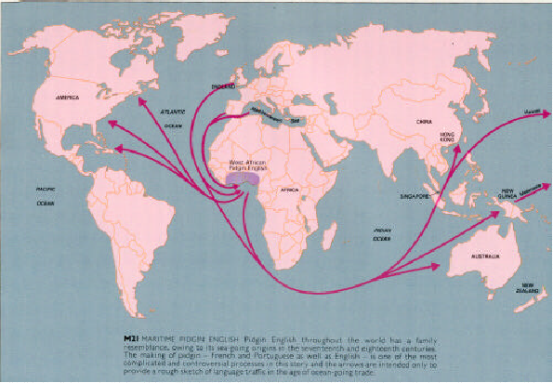
The forcible exile of over 12 million Africans to work the plantations of European colonists.
Notes:
seventeenth century: European settlers establish colonies in the new world, simultaneously with the early capitalism slavery developed
→ The Sale Triangle: Europe-Africa-`New World`
first triangle leg: -ships set off from ports in Europe ( e.g. Liverpool, Bristol,Amsterdam) for the west coast of Africa.
-numerous slave factories along the Gulf of Guinea ( ``slave coast ``)
second triangle leg: -inhuman and harsh journey from Africa towards the West Indies or the other New World colonies
third triangle leg: -return to Europe with New World products such as sugar and tea.

Slide 46
Profile of a Slave Ship
Name of ship: Zong
Left Sãn Tomé 6 September 1781
Slaves on board 440
White crew 17
Arrived in Jamaica 27 November 1781
Slaves deceased 60
Crew deceased 7
Slaves sick on arrival, likely to die greater than 60
Price per slave in Jamaica 20-40 pounds
from The Memoirs of Granville-Sharp
(text p. 284)
Notes:
Plantation economy: use of imported labour on a massive scale under the control of small numbers of Europeans.
1600s through about 1850.

Slide 47
Two Locations
Fort Creole: developed at fortified posts along the west African coast, where European forces held slaves until the arrival of the next ship.
Guinea Coast Creole English
Plantation Creole: developed on plantations in the New World colonies under the dominance of different European languages.
Jamaican Creole Jamaica English
Negerhollands Virgin Islands Dutch
Haitian Creole Haiti French
Papiamento Netherlands Antilles Spanish
Angolar Sãno Tomé Portuguese
Notes:
Plantation economy: use of imported labour on a massive scale under the control of small numbers of Europeans.
1600s through about 1850.

Slide 48
2. Trade
Naga Pidgin
Contemporary pidgin spoken by peoples in mountain regions of north-east India.
Acts as lingua franca (29 languages)
Originated as a market language in Assam in the 19th century among the Naga people
Undergoing creolization among small groups like the Kacharis in the town of Dimapur, and among the children of interethnic marriages.

Slide 49
3. European settlement
movement of European settlers to places where
the indigenous population had not been decimated or moved into reservations
a slave population did not form the labor force
Fanakalo
spoken in parts of South Africa
vocabulary from Zulu, and some from English & Afrikaans)
stable pidgin, shows no signs of creolizing

Slide 50
4. War
Korean Bamboo English
American wars in Asia (Japan, Korea, Vietnam, Thailand)
marginal, unstable pidgin
Read story of Cinderella-San, Wardhaugh pp. 71-2

Slide 51
5. Labor Migration
within colonized countries, people from different ethnic groups may be drawn into a common work sphere without being forced
Tok Pisin in Papua New Guinea (Pacific Islands)

Slide 52
4. Linguistic Features of Pidgins

Slide 53
Examples
Two pidgins for which English supplied much of the vocabulary
Cameroonian Pidgin, Cameroon, West Africa
Korean Bamboo English, Korea

Slide 54
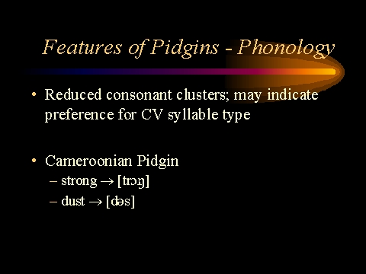
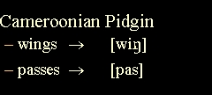
Phonology
Tend to reduce consonant clusters.
Lack Affixes

Slide 55
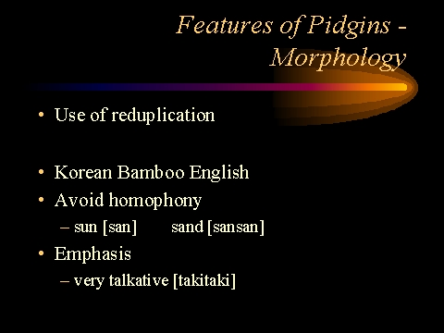
Morphology
Use Reduplication. (as in English ‘purple’)

Slide 56
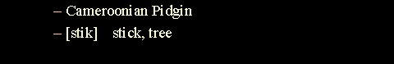
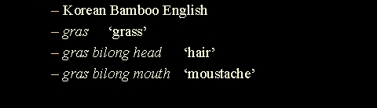
Lexicon
Reduced vocabularies
Polysemy
Circumlocution

Slide 57
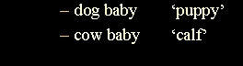
Lexicon
Compounding

Slide 58
Grammatical Structure
“Often complete lack of inflection in nouns, pronouns, verbs, and adejectives”
Wardhaugh 67
Lack articles (e.g. the, a, an)
Preference for compound sentences, not complex.
very few suffixes and grammatical markers
Time usually expressed with adverbs instead of inflection
Chinese Pidgin English
Before my sellum for ten dollar
PAST 1sg sell for ten dollars
I sold it for ten dollars.

Slide 59
Not always “polite” bagarap ka bilong me I bagarap Wardhaugh, p. 68

Slide 60
Linguistic artifacts are absent. Spellings such as ‘knight’ and words which show historical vowel shift like ‘type’ vs ‘typical’ also, though a shift in consonant pronunciation rather than in vowel is ‘space’ ‘spacious’ It is as if these new languages are too young to have the wrinkles that older languages develop

Slide 61
5. Pidgin Development

Slide 62
Theories for structural similarities
1. Monogenesis & relexification (Portuguese)
2. Independent parallel development (“foreigner talk”)
3. Linguistic universals

Slide 63
Classifying Pidgins: Grammatical Complexity
Less Complex
Pre-pidgin (or jargon)
Stable Pidgin
Expanded Pidgin
More Complex

Slide 64
Expanded Pidgins
Pidgins that have developed a more formal role, as regular auxiliary languages. May have official status as lingua francas.
Linguistically more complex to meet needs.
Used for more functions in a much wider range of situations.
Tok Pisin (Papua New Guinea) c. 1880
expanded pidgin currently undergoing creolization. Now has about 20,000 native speakers.
about 44% of the population

